Slide 1

Mojaloop Foundation and GLEIF
Partnership
PI 26 Convening
November 2024

Slide 2
Background
We are seeing convergence around the need for a more formal approach to payments addressing, as it relates to P2M:
Merchant Payments workstream has completed (for now); encompassing Merchant Registry and the use of scheme-specific merchant IDs for addressing
Implies a role for formalised registration, anti-fraud measures etc.
COMESA deployments are intended to encompass cross-border merchant transactions
So merchant identities must cross-borders with them
FATF Travel Rule will require extensive counter party identification with all transactions
But: the revolution can be tokenised.

Slide 3
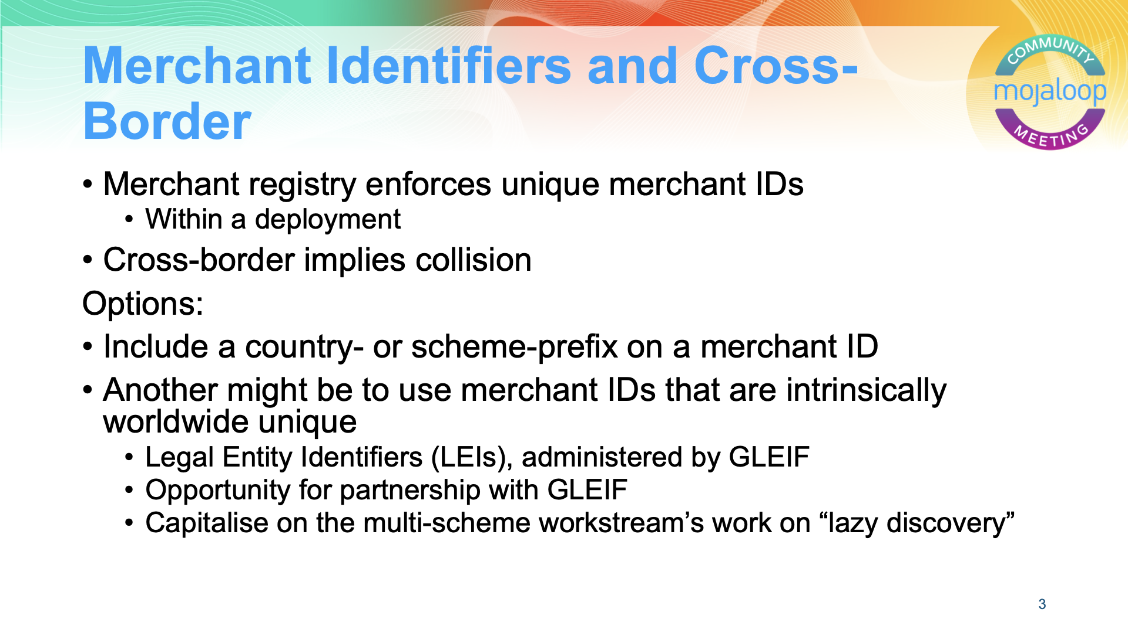
LEIs
Long (20 digits
alphanumeric)
Unique worldwide
Only useful for larger businesses
Not usable for USSD; only QR

Slide 4
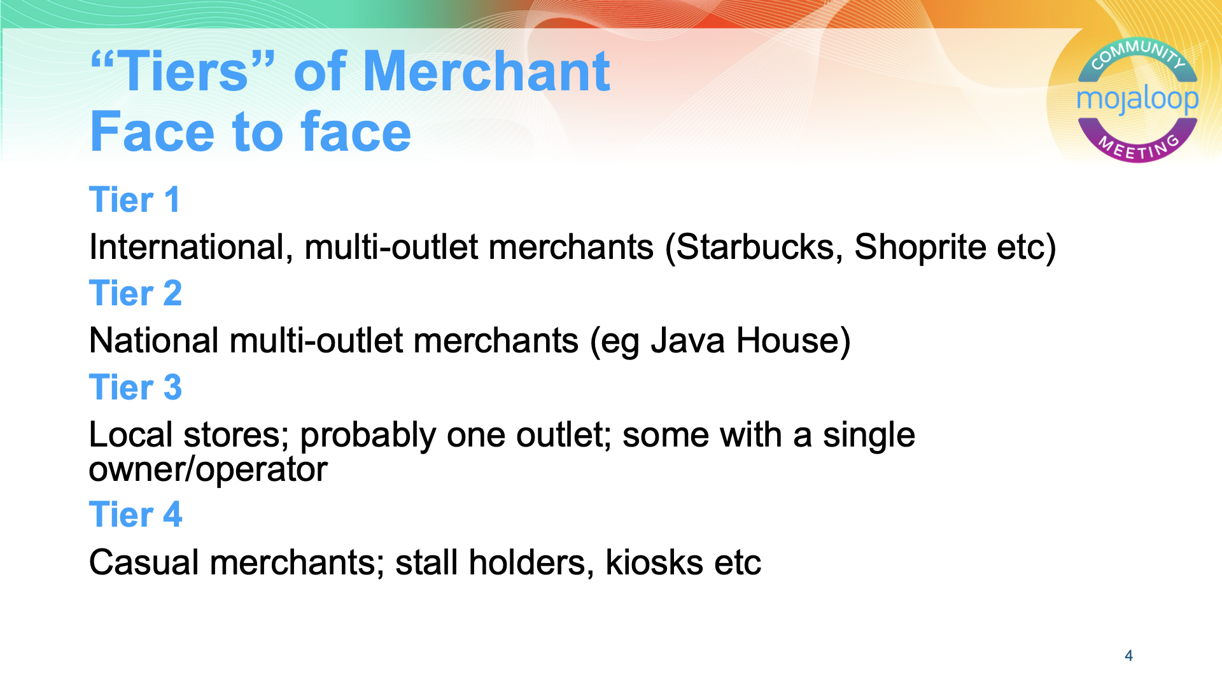

Slide 5
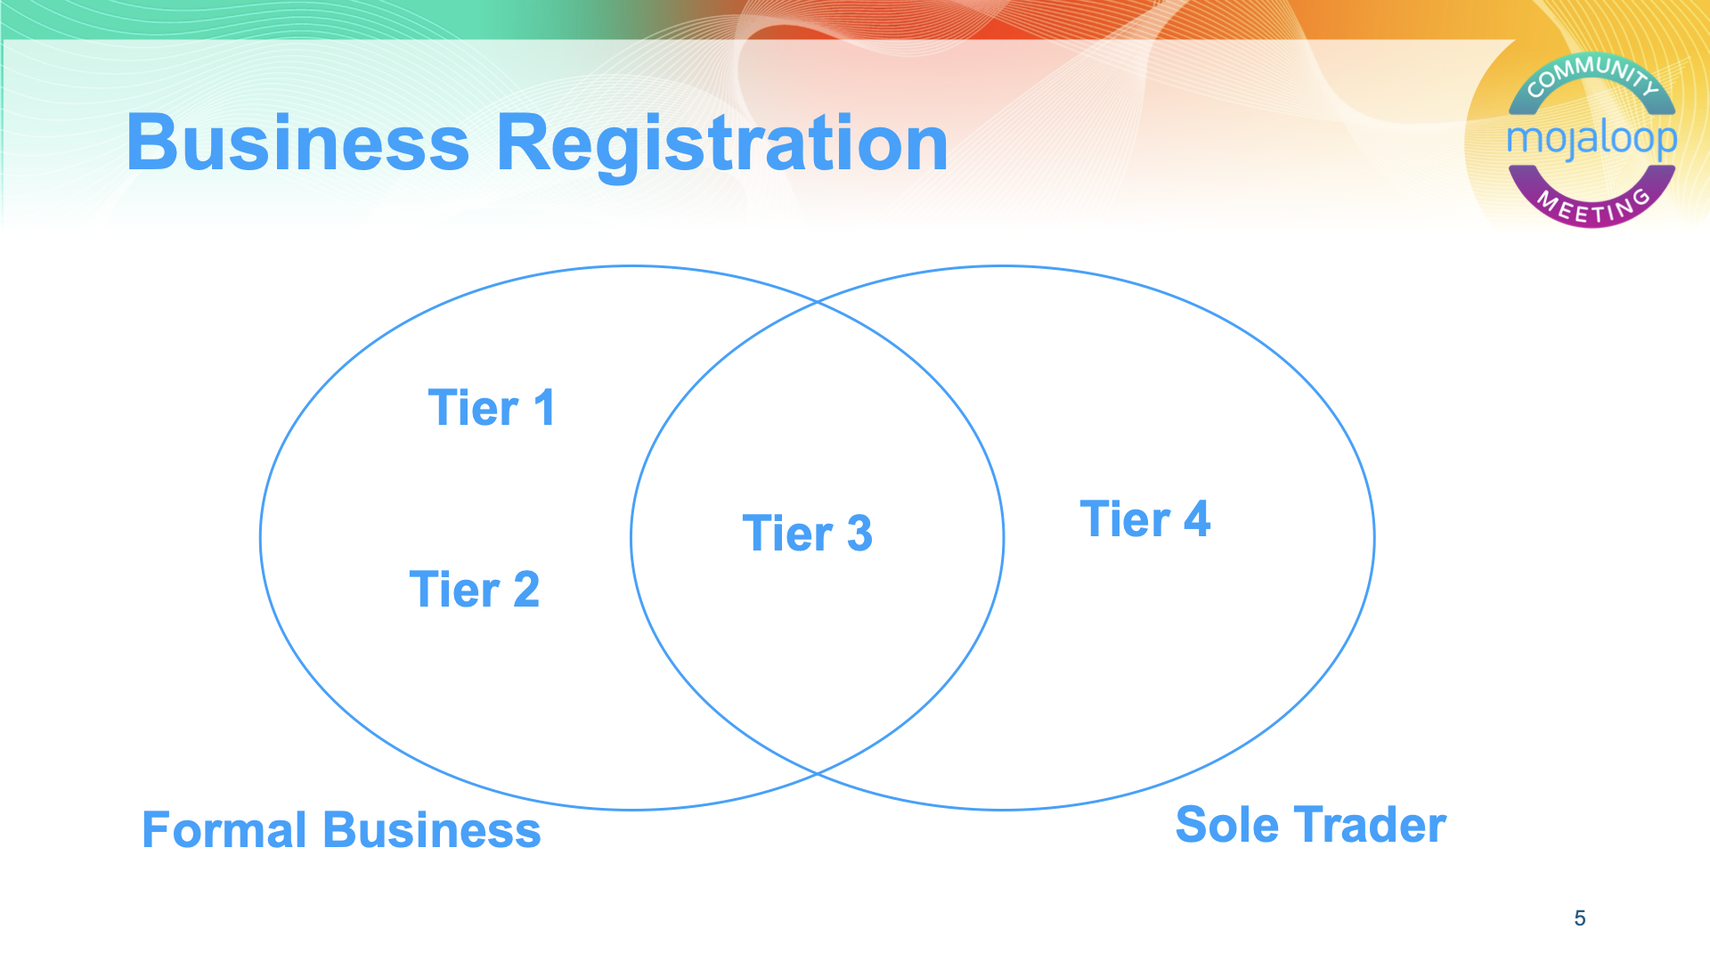

Slide 6
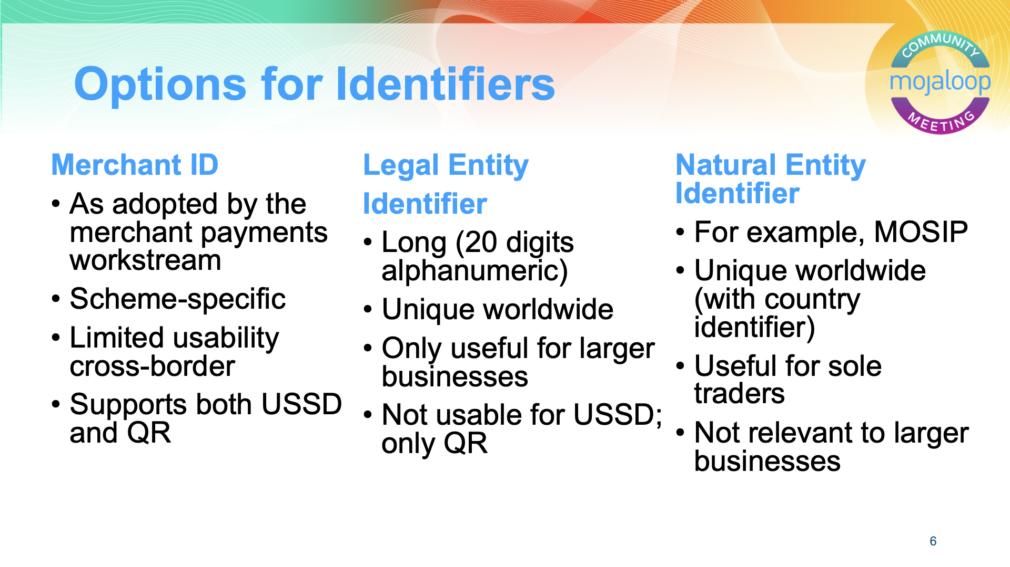
LEIs are a game changer for KYB, but they’re not a silver bullet. Need complementary solutions for sole traders, and need to improve registration in our focus countries.

Slide 7
Also, The Verifiable LEI (vLEI)
Provides instant, automated identity verification of legal entities and their persons in official and functional roles.
Verification can be cryptographically bound to official documents, transactions and interactions.
⇒
Hub Operators and DFSPs should have LEIs
Using vLEIs, these legal entities can appoint staff to represent themselves to each other
Roles and authorisations can be verified using vLEI
Enhances operational security

Slide 8
Given these synergies….
…it should come as no surprise that the Mojaloop Foundation and GLEIF are entering into a partnership agreement
This is intended to lead to a PoC/pilot
Preferably relating to cross-border merchant payments
Exploration of the applicability and utility of vLEIs would also be welcome

Slide 9
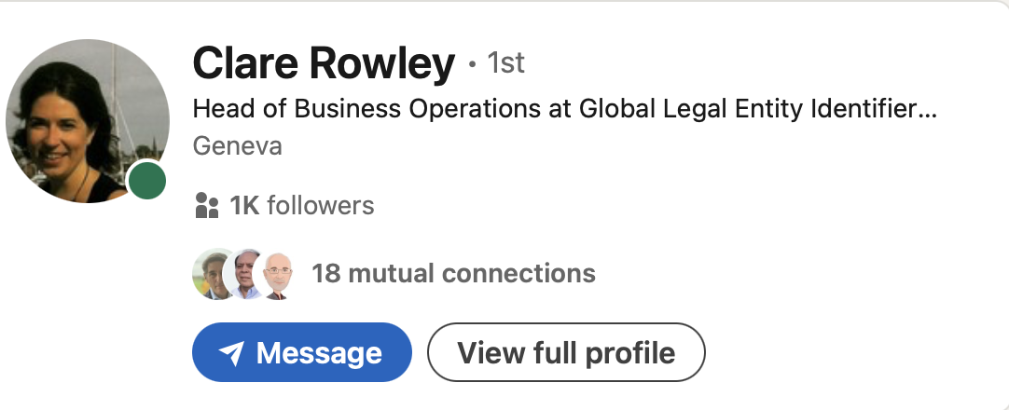
Over to…..

Slide 10
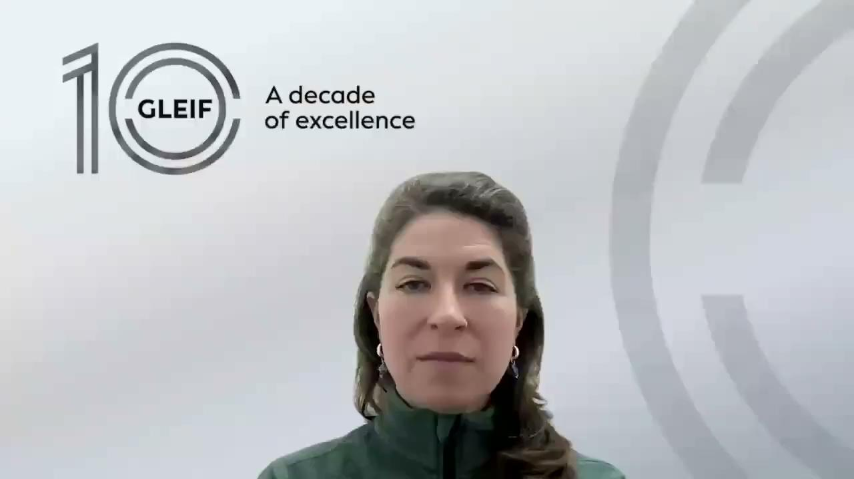

Slide 11
Discussion
Clare Rowley
Arunjay Katakam
Paul Makin
How can this new partnership be used to increase LEI registration?
How should it be complemented to address other use cases?
What about the casual trader? Is there an international way of addressing payments to people, trading as informal businesses?
Is there an opportunity to extend LEI registration down to Tier 4 - at appropriate cost?

